Slide 1

Deployment models and private cloud platform construction

Slide 2
Intended learning outcomes
After completing this topic, you will be able to:
Understand different cloud deployment models
Use the cloud computing virtualization technologies to construct private cloud platform

Slide 3
Private cloud
A cloud computing environment in which all hardware and software resources are dedicated exclusively to, and accessible only by, a single party

Slide 4
Private cloud vs Public cloud (1)
Private cloud
dedicated to the needs and goals of a single organization
Public cloud
Delivers services to multiple organizations

Slide 5
Private cloud vs Public cloud (2)
Private cloud delivers similar advantages to public cloud, including scalability and self-service, but through a proprietary architecture
Private cloud is a single-tenant environment

Slide 6
Single-tenant environment
Tenant - the organization using the cloud
In single-tenant environment the tenant does not share resources with other users

Slide 7
Single-tenant environment
Tenant - the organization using the cloud
In single-tenant environment the tenant does not share resources with other users
What does it mean that the resources are not shared?

Slide 8
How are the resources hosted in private clouds?

Slide 9
Example
Let’s consider an example of an enterprise with multiple business units
Business need: data storage
Resource: private data center

Slide 10
How can the resources be hosted and managed?

Slide 11
How can the resources be hosted and managed?
Option 1 – private data center
Organization's on-premises data center
Owned and hosted on organization’s premises
Managed by organization

Slide 12
How can the resources be hosted and managed?
Option 2 – public cloud
Hosted by another organization on shared resources

Slide 13
How can the resources be hosted and managed?
Option 3 – private cloud
Hosted on resources dedicated to the organization (not shared)

Slide 14
Example (cont.)
Organization wants to adopt cloud computing technology
Migrate to private cloud

Slide 15
Migration to private cloud
Cloud migration is the process of moving digital assets — like data, workloads, IT resources, or applications — to cloud infrastructure.
Cloud migration commonly refers to moving tools and data from old, legacy infrastructure or an on-premises data center to the cloud.

Slide 16
Constructing a private cloud
Cloud infrastructure
components needed for cloud computing
the basic elements of cloud infrastructure are the same whether you have a private cloud, public cloud, or hybrid cloud.
Operating system+ a variety of bare-metal, virtualization, or container software that abstract, pool, and share scalable resources across a network.
The IT staff that is equipped to manage private cloud environments

Slide 17
How can the resources be hosted in private clouds?

Slide 18
On-Premise/Internal private cloud
Motivation
Better utilization of resources
Maintain full control
The private cloud is based on resources and infrastructure already present in an organization's on-premises data center
The organization/enterprise hosts a cloud environment internally

Slide 19
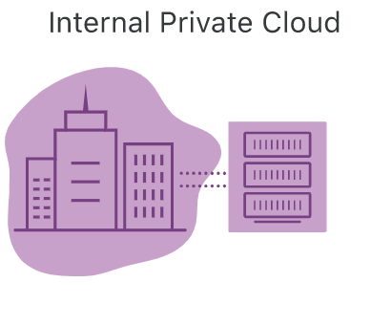
On-Premise/Internal private cloud
In this model, who is
Cloud provider/service provider?
Customer/user/cloud tenant?

Slide 20
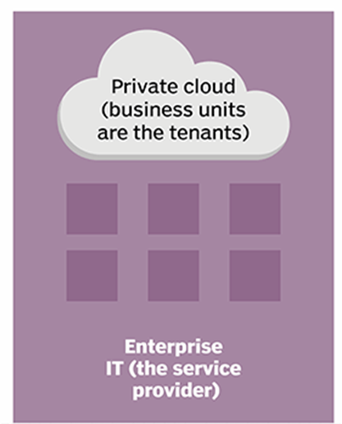
On-Premise/Internal private cloud
Infrastructure is owned and managed by the enterprise’s own IT team
Enterprise IT becomes the service provider
Enterprise’s business units use resources hosted in the private cloud
Business units are cloud tenants

Slide 21
On-Premise/Internal private cloud benefits
Very secure
internally hosted and managed by an organization’s internal IT department
the organization has complete control over the security, configurations, and scalability of its servers

Slide 22
On-Premise/Internal private cloud benefits
Higher cost
Can include the cost of purchasing and installing new hardware and software and the cost of managing it (which may involve hiring additional IT staff.)
Limited flexibility
once an organization invests in hardware and software for its private cloud, adding capacity or new capabilities requires additional purchases

Slide 23
How are the resources hosted in private clouds?

Slide 24
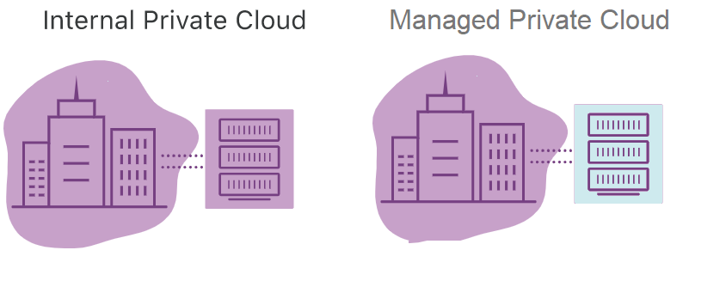

Slide 25
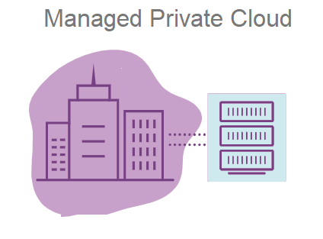
Managed
Responsibility for managing and maintaining the infrastructure is outsourced to a third-party service provider.
The physical hardware
usually resides in the service provider’s data center
vendors also offer management services for infrastructure located in an enterprise’s own data center
The provider maintains every part of the cloud for the enterprise, including the deployment of additional services like identity management and storage.
A good alternative for companies that don't have the resources to run private cloud systems on their own

Slide 26
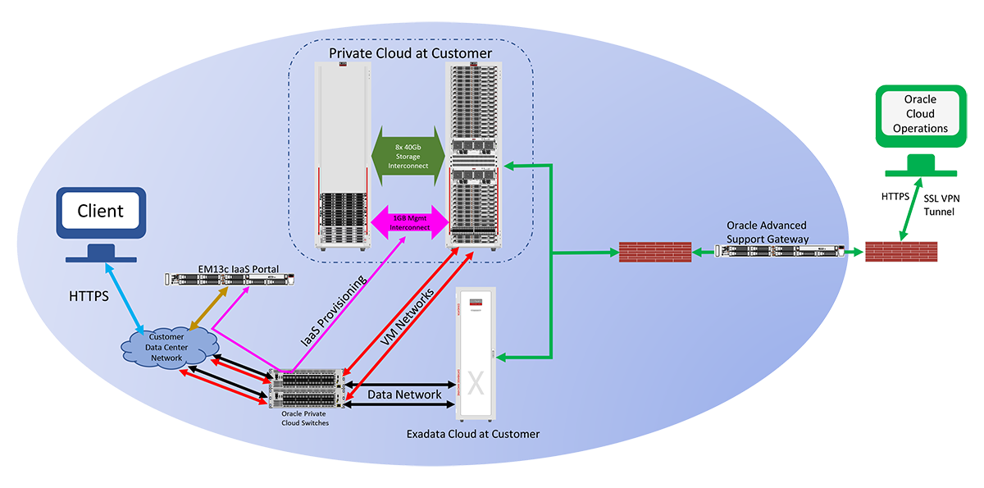
Example - Oracle Private Cloud at Customer
Infrastructure managed by Oracle but deployed inside inside customer own data centers

Slide 27
Architecture of Oracle Private Cloud at Customer
A web-based self-service management interface gives the customer interactive access to service administration functions
Oracle monitors and manages the infrastructure components
the physical compute node hardware
network switches
power distribution units (PDUs)
Oracle Integrated Lights Out Manager interfaces (ILOMs)
the storage
These operations are performed remotely by Oracle using the Oracle Advanced Support Gateway

Slide 28
Manage private cloud example – Atlantic.Net
Atlantic.Net's Managed Virtualization
provides a managed private cloud hosting solution
utilizes enterprise-level hardware running industry standard hypervisor software

Slide 29
Services offered in managed private cloud
System Environment
Clustering
VM Provisioning
System Updates
Replication and Failover
Advanced Certifications
Advanced Monitoring
Additional VM Services
Managed Private Cloud Infrastructure

Slide 30
System Environment
Up-to-OS management and support
Active administration of host server resources, including CPU, network, and hard disk utilization

Slide 31
Clustering
Offers the ability to migrate VM to another host server in case of system failure or load balancing between servers
Allows for redistribution of Virtual Machines amongst multiple host servers and the ability to configure a shared storage node to provide VM Hypervisor management and automated failover of a clustered computing node
This is done by increasing memory/CPU per computing node, since VM hard disks are located on a shared storage

Slide 32
VM Provisioning
VM creation, cloning, and removing
Initial private networking setup and VLAN tagging (to segment traffic between individual VMs)
A self-service portal enables customers to start, stop, and console in to any configured VM

Slide 33
System Updates
Prior to updating the host server, each new update is reviewed and tested to ensure that there are no issues with the system
Any necessary restarts will be scheduled
Hyper-V deployments make use of cluster aware updating, ensuring 100% uptime while updating each node in the cluster.

Slide 34
Replication and Failover
Virtual Machine replication is designed to provide cross-node fault tolerance by increasing the necessary storage, memory, and CPU requirements for a separate dedicated computing node

Slide 35
Advanced Certifications
Microsoft Certified Professionals, and Red Hat Enterprise Linux Certified Engineers on staff to assist with all VM design, configuration, and deployment

Slide 36
Advanced Monitoring
Service provider will ensure the hardware, virtualization hypervisor, and all VMs are always functioning properly

Slide 37
How are the resources hosted in private clouds?

Slide 38
Hosted private cloud

Slide 39
Hosted private cloud
The private cloud is based on new, separate infrastructure, which is provided by a third-party organization
The environment where infrastructure is both hosted and managed by the cloud provider itself

Slide 40
How hosted private cloud works
The cloud provider allocates a particular server to a particular organization
The server’s resources are not shared among other organizations
The organization only uses the resources and can access them as per the demand
The cloud provider is responsible for managing, updating, and configuring the hardware, software, and network

Slide 41
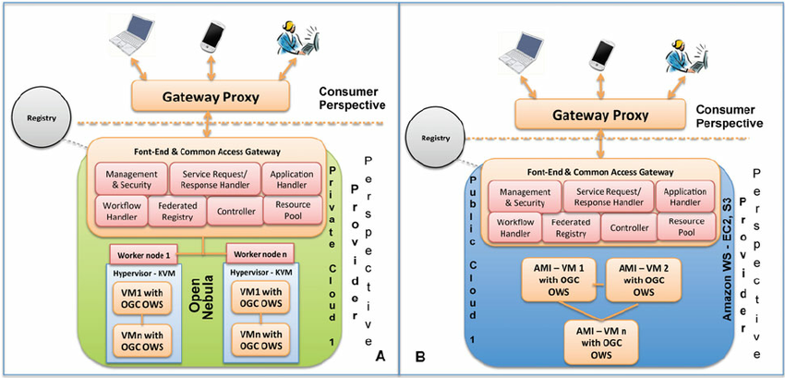
Hosted private vs public cloud

Slide 42
Hosted private vs public cloud (2)
From the customer perspective both options have some similarity- the service provider configures the network, maintains the hardware and updates the software
However, in a hosted private cloud environment, the servers are not shared with other organizations

Slide 43
Hosted private cloud benefits
Hosted private cloud vendors offer cloud servers in their own data centers and are also responsible for security management
Users get access to
additional resources
a support team
high-demand scalability options
a user-friendly dashboard to assist in server management

Slide 44
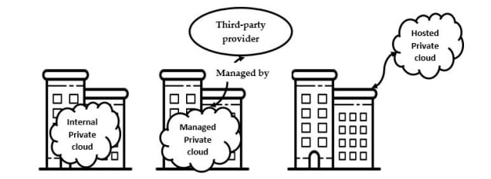
Internal vs Managed vs Hosted

Slide 45
How are the resources hosted in private clouds?

Slide 46
Virtual private cloud
A secure private cloud that is hosted remotely by a public cloud provider
The single-tenant environment is enabled solely using virtualization software

Slide 47
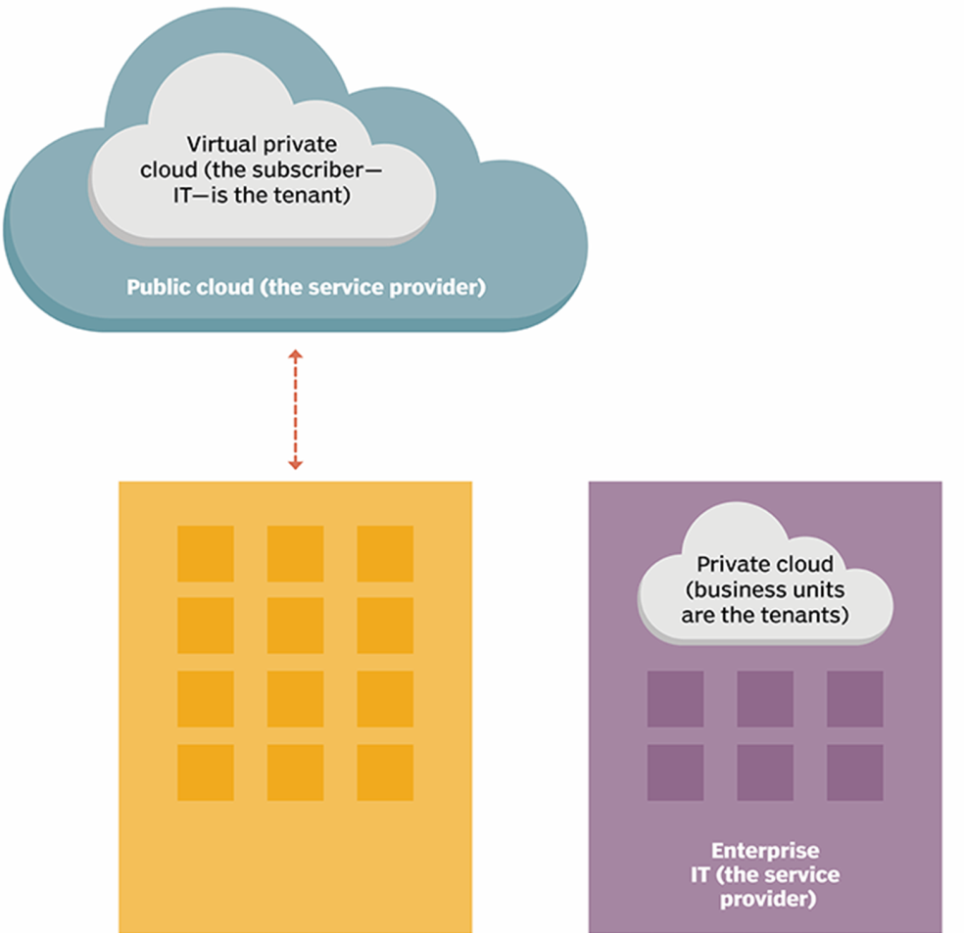
Virtual private cloud
A walled-off environment within a public cloud that allows an organization to run their workloads in isolation from every other user of the public cloud
Even though the server is shared by other organizations, the virtual logic ensures that a user's computing resources are private

Slide 48
Virtual private cloud benefits
VPC customers can benefit from the public cloud’s
Resource availability
Scalability
Flexibility
Cost-effectiveness
Retaining much of the security and control of private cloud
The ability to define and control a logically isolated space in the public cloud
Offers the private cloud’s enhanced security within a multi-tenant environment

Slide 49
How to create a virtual private cloud - example
VMware vCloud® Air™ Virtual Private Cloud OnDemand
Create an Account
Create a Virtual Machine
View and Monitor Resource Usage

Slide 50
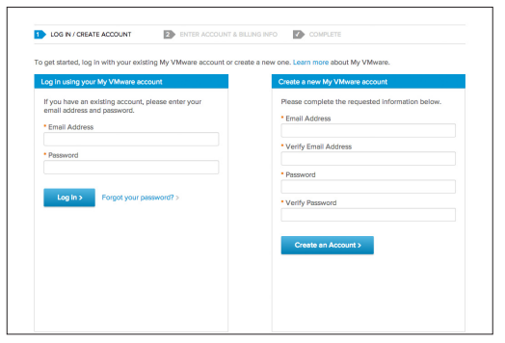
Create an account
a browser
a credit card

Slide 51
Create a Virtual Machine
When you log in to Virtual Private Cloud OnDemand the first time, a virtual data center named “VDC1” is automatically created with a routed network and gateway
A virtual data center is an environment in which virtual machines are stored, deployed, and operated
You can create one or more virtual data centers to expand your capacity limits exponentially and to organize resources into more-manageable chunks.
You can change the name of a virtual data center or delete it (and its associated virtual machines).

Slide 52
Create a Virtual Machine
To create your first virtual machine, simply click Create Your First Virtual Machine, and a wizard walks you through an easy two-step process:
Select a virtual machine
Select your desired resources

Slide 53
Select a Virtual Machine
Select a predefined template
Create an original virtual machine

Slide 54
Predefined template
Select a predefined template
from the VMware Public Catalog - an operating system and application catalog of commonly used, preconfigured workloads
from a list of your catalogs that have been uploaded under My Catalog

Slide 55
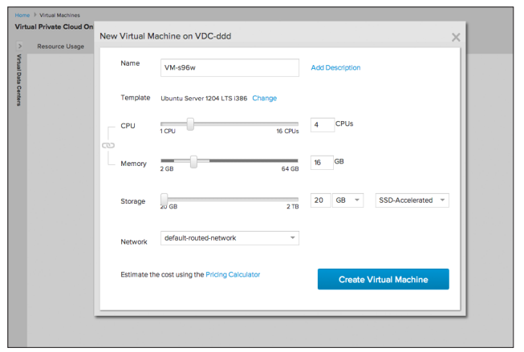
Select desired resources
Use the wizard’s slide scale to select your desired CPU, memory, storage, and network connection
You can adjust the CPU, memory, and storage resources of any virtual machine on the fly
Simply select the virtual machine you want to change and select Edit Resources from the Actions menu.

Slide 56
Create an original virtual machine
If you don’t want to create a virtual machine based on a template, you can create an original virtual machine in VMware vCloud Director®
Select Create My Virtual Machine from Scratch, which routes you to create a vSphere vApp™ and its virtual machines

Slide 57
View and Monitor Resource Usage
You can view resource usage data
for all virtual machines in a virtual data center
for specific virtual machines
Data is aggregated to display
monthly totals for storage usage
hourly totals for vCPU, vRAM, public IP addresses, and license usage
You can view resource usage by
month to date
the past 24 hours
the past hour
Enables you to pay for only the resources you use, on a per-minute, metered basis

Slide 58
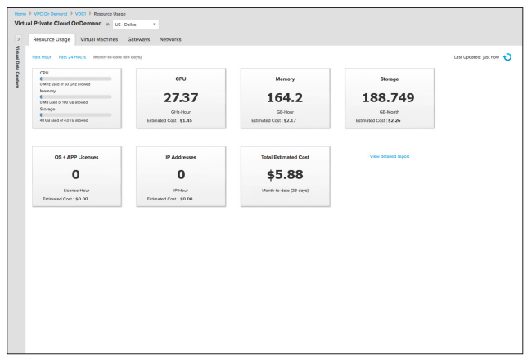

Slide 59
Types of private clouds
Virtual
Hosted
Managed
On-premise/Internal
All private clouds offer an isolated environment
Different types of private clouds are classified into categories based on how they are hosted and how much management they receive from the provider

Slide 60
Types of private clouds

Slide 61
Advantages of private clouds (1)
Most of the same benefits found in public clouds
user self-service and scalability
the ability to provision and configure virtual machines (VMs) and change or optimize computing resources on demand

Slide 62
Advantages of private clouds (2)
Users don't share resources
Increased security of an isolated network.
Increased performance due to resources being solely dedicated to one organization
Increased capability for customization

Slide 63
Security benefits
Greater visibility into security and access control
All workloads run behind the customers’ own firewall
Fully enforced compliance with regulatory standards
Private cloud customers aren’t forced to rely on the industry and regulatory compliance offered by the cloud service provider

Slide 64
Customization benefits
Full control over hardware and software choices
Private cloud customers are free to purchase the hardware and software they prefer, vs. the hardware and software the cloud provider offers
Freedom to customize hardware and software in any way
Private cloud customers can customize servers in any way they want and can customize software as needed with add-ons or through custom development

Slide 65
Private cloud vs Public cloud choice
Private cloud computing model is best for businesses
With dynamic or unpredictable computing needs
That require direct control over their environments, typically to meet security, business governance or regulatory compliance requirements

Slide 66
Types of private clouds
Virtual
Hosted
Managed
On-premise/Internal
All private clouds offer an isolated environment
Different types of private clouds are classified into categories based on how they are hosted and how much management they receive from the provider

Slide 67
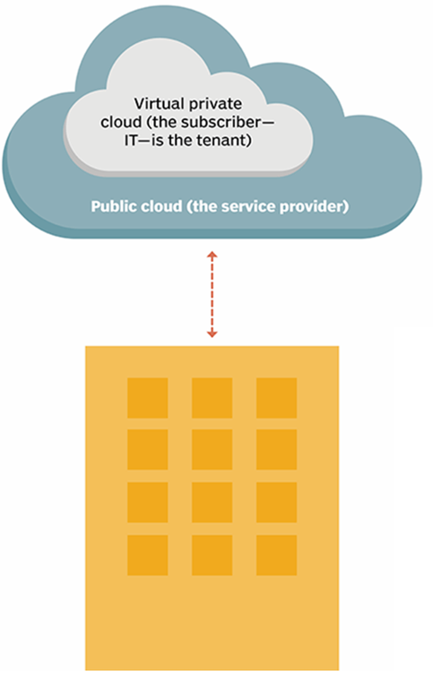
Private cloud types

